Slide 1



An introduction to meta-analysis
Tissue distributions of organic pollutants in wild bird populations
Francesca Gray
ro1fg19@abdn.ac.uk
Notes:
Hi everyone. For those who do not know me, I’m Francesca, I typically go by Chess. My PhD focuses on looking at the effect of organic pollutants on alpine swift colonies. Like everyone else, Covid had a big impact on my work and I have had to navigate more to desk based work and this is how my meta analysis came about.
So first things first, I just want to say that I am not a meta-analysis expert – not even close actually! I have spent the good part of a year learning as I go on this.
I agreed to do this presentation because, if you do decide to do a meta-analysis, it can seem like a bit of a black hole and potentially a little intimidating. And I hope that, for anyone whose considering doing one, this talk may help you get off the ground. I have done it as visually as possible and I hope this will provide a good practical guide for you.
I will not massively go into statistics on this, partly because I haven’t had a chance to see my work through yet, but also because 95%, maybe even more, of the work goes in before you get to the stats. I have touched upon the stats mainly to make sure you know what your options are and what you are aiming at but my primary focus here is understanding the data collection and giving you confidence to do the same. My aim here is to give you a really practical explanation on a meta-analysis, using my one as an example.

Slide 2

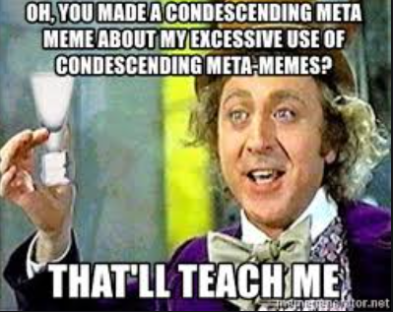

What is a meta-analysis?
Self-referential
Meta-analysis – a statistical synthesis of results from a series of studies.
A study about studies!
Notes:
So obviously, where we are going to start is what is a meta analysis?
The definition I found in my trusty meta-analysis book, is that a meta-analysis is a statistical synthesis of results from a series of studies. This definition honestly puts me right to sleep.
But it stems from the word meta and it is basically a study about studies. Other examples of meta are these random Spongebob and Charlie and the chocolate factory memes that are just so strong that I couldn’t say no to putting them in here. A good example of meta usually can be found in films and TV. For example, in Deadpool 2, he goes back in time to X-men 3, 5 I don’t remember and shoots himself in the head to “clean up the timeline” – that’s meta, I think… Then there is that Rick and Morty episode where they make Rick and Morty episodes that’s definitely meta. I also once saw a meta analysis on meta-analyses when I was looking for my memes and that made me laugh.
Meta is basically self-referential. But the phrase “a study about studies” is not massively helpful so I am going to go through it in a little more detail.

Slide 3
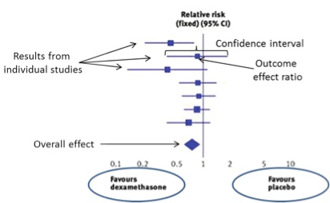
Why do a meta-analysis?
General principles:
Done systematically
Contains a pool of results
Is based in quantitative analysis
It is very important to be unbiased throughout in your search criteria and be consistent – not doing so can produce misleading results.
Notes:
And the outcome of a meta analysis is demonstrated using forest plots which I am sure everyone here has seen before but if you haven’t don’t worry yourself, I have a slide towards the end that goes into reading them. Nicked this one off of google images. It is 100% not mine. But are you can see here, you have different studies down the side and this big diamond at the bottom is the overall result of combining all these studies together.
So, general principles. A meta analysis is done systematically. So, there is a process to finding and collecting the studies included in your meta analysis which in a way, removes you from the equation, and takes out the bias of your knowledge on the literature.
So, it contains a pool of results, this is self-explanatory really but by being regimented in your paper collection, you end up with a definite pool of papers and thus results that you then run your stats off. And, it is, of course, quantitative, so there are obviously certain limitations to it.

Slide 4
Why do a meta-analysis?
It is all about getting an integrated result – finding an overall consensus
Medicine, psychology, criminology, ecology
When is this helpful?
“Increases” sample size
Establishes statistical significance or lack thereof
Notes:
At the end of the day, when it comes down to it, it is all about getting an integrated result, collecting papers looking at the same thing, and integrating their data together.
This is used in many different fields, medicine likely being the original one.
Drug trials are a great example. By collating a series of studies together, you can produce a more powerful test to estimate a drug’s effect. This can be used for the drug’s effect but it can also be used for adverse effects. This could be done in-house by pharmaceutical companies or there are organisations that focus on this. By doing this, we are ensuring treatments are based on the best available empirical data.
Psychology really follows on from this and could be anything from understanding how the world around us is influencing behaviour, to guiding support on mental health.
Criminology is a great one too. So, governments often fund meta analyses to examine the relative effectiveness of various programs in reducing criminal behaviour whether to reduce delinquency or the chances of individuals reoffending. They can also use it to understand the effectiveness of difference police patrols.
And my favourite, which is why it is in fancy bold, is ecology. The examples are endless but one of my favourites is aiding the effectiveness of conservation management interventions because this helps guide conservation efforts which I think is really cool.
What a meta analysis really helps overcome in ecology is the high levels of random variation in field studies which is something that a lot of us here are likely up against. By cumulating studies together, we increase our power to help us overcome this. With no overall consensus in the literature, it is difficult to draw overarching conclusions and a meta analysis can help overcome this as well.
So when is this helpful?
Meta-Analysis "Increases" Sample Size
One of the reasons why meta-analyses are so useful is because of an all too common problem across many research studies: small sample sizes. And for those in field studies, high random variation.
Using a large sample size requires more resources, including funds and personnel, than a small sample size. When individual research projects don't study a significant number of subjects, it can be difficult to draw reliable and valid conclusions.
We also have establishing Statistical Significance
Which can be done across studies that might otherwise seem to have conflicting results.
When you take many studies into consideration at once, the statistical significance established is much greater than with one study alone. This is important because statistical significance increases the validity of any observed differences and increases the reliability of the information.

Slide 5
Tissue distributions of organic pollutants in wild bird populations
Working example
Notes:
So, that was, probably quite a rough introduction into a meta analysis so sorry about that. Now, we are going to move onto a bit of background information on my meta analysis topic which I will be using as a working example and it is tissue distributions of organic pollutants in wild bird populations.

Slide 6






Persistent Organic Pollutants (POPs)
Travel long distances
Persistent in the environment
Bioaccumulate in individuals
Biomagnify up the food chain
Notes:
So, the organic pollutants I focus on are POPs. And these are a group of manmade organic pollutants that fit a subset of characteristics.
They travel long distances. This means that although they are banned in most countries, because they can travel, they are still a global issue. They are also difficult to track due to this.
They persist in the environment. So they have a long half life and can take years, decades even, to break down.
They bioaccumulate. This means they build up in individuals over time meaning that older individuals can have more POPs than their younger counterparts and this introduces both within and between population differences that make overall comparisons difficult.
POPs biomagnify up the food chain. This means that, as an example, carnivores often have more POPs in their system than say insectivores, once again introducing variation within and between individuals.
They are also bad. They can have a whole host of nasty effects dependent on their concentrations. Eggshell thinning and reduced reproduction are key examples but there are lots of other effects, from endocrine dysfunction to death.

Slide 7


Measuring POPs in wild populations
Challenging between-study comparisons
Some variation is uncontrollable - POP exposure, wild populations
Other variation we can focus on…
Notes:
So in this study field, comparing between studies or populations often proves tricky. There is the typical issue of high variation in wild populations but there are also add challenges when measuring POPs.
There is the unpredictability of POP movement in the environment. On top of that, POP presence in the environment does not mean exposure for your species. There are also lots of different exposure routes for an individual which can be dependent on anything from country to local differences in access to water and foraging routes.
There are also differences among individuals within a population – this could be differences in exposure due to behaviour. There are also differences in bioaccumulation dependent on sex and age.
This often results in large differences between papers and lack of comparability. But there is other variation that we can work with

Slide 8







Tissue dependence
Killed for the study or recently deceased (i.e. roadkill)
Living before and after sampling
Invasive
Minimally-invasive
Blood
Organs
Feathers
Muscle
Preen oil
Notes:
Tissue dependence is the focus of my meta analysis and is a great example of variation in the literature that we can control. So tissue distribution is simply which tissue you use to calculate a POP concentration for the individual you took the sample from.
There seem to be two main types of papers for this.
One of these is where individuals are killed for the study or have been recently deceased. These papers more often than not use invasive tissues.. Organs.. Muscle… etc.
The other is papers aiming to be minimally invasive. This is done with endangered species or when using a long-term study population and these use feathers, preen oil, but more often than not, blood. And we are finding that these minimally invasive papers are becoming more frequent due to an increase in animal welfare awareness.
The issue here, is that feather and preen oil, as POP measures, have not been used as much and thus are not as fully understood.
So, if we understand tissue differences more in this field, there are two wins. 1, we increase our between-study comparisons. And the second, is that we can increase our understanding of non-invasive measures

Slide 9



Study format
Understand our invasive measures
Understand our minimally invasive measures
Compare between invasive and minimally invasive measures
Notes:
So, this is my aim. A meta analytic study broken down into three sections. First section is to understand how invasive measures correlate. The next is understanding more how non-invasive measures correlate. And finally, how invasive and non-invasive measures correlate.

Slide 10
How to do a meta-analysis
Step 1: Collect your paper pool
Notes:
So for this meta analysis, I need papers that include a tissue comparison for POP measures in wild bird populations.
And I will now go through how I do this.

Slide 11
Collect your provisional paper pool
Choose your search engine(s)
Develop a search
Go through all paper abstracts to determine acceptability
Notes:
So, to collect your paper pool you need to do three things. Choose your search engine, develop a search and go through all paper abstracts to determine acceptability. I will now go through these

Slide 12


1. Choose your search engine(s)
“Scopus is good for a comprehensive study while WoS is better for selective data. That is, for a review article I would prefer Scopus, but for an elaboration on specific scientific problem I would prefer WoS.” – Avishag Gordon on ResearchGate
Ecology typically use either Web of Science or Scopus
(which is better? Depends on what you want and who you ask)
Both multidisciplinary
Scopus is more inclusive as Web of Science has a more stringent vetting process
Notes:
So choosing your search engine. For a meta analysis in ecology, more often than not, you are looking at Scopus or Web of Science and you can’t go wrong with either of them.
I chose Scopus simply because I am more confident with it, I have honestly barely ever used Web of Science because I use Scopus. I have looked into this topic of, which one is best, and it honestly comes down to who you ask more often than not. The metrics between everyone seems to give and usually not directly comparable which I enjoy as well. The main difference that comes up time and time again is that Web of Science has a more stringent vetting process so I imagine medical journals likely use Web of Science but I enjoy the inclusivity of Scopus. In a meta analysis there is also nothing wrong with repeating the search for both search engines and some meta analysis studies so this but it is completely optional.
I like this comment that I found on research gate that probably sums it up quite well…

Slide 13

2. Develop a search
Your search needs to contain each aspect of your research question
Pollutants
Bird
Tissues
Wild
Use your title
Tissue distributions of organic pollutants in wild bird populations
You want to catch papers that match your criteria whilst making your search as selective as possible – it is a balancing act!
Notes:
Your search needs to contain each aspect of your research question. The best way to do this is to just use the title of your study like so…
Once you have your categories, you then need to sit down and make a list of all the synonyms you can think of for them. I mean, really brainstorm. Often I find it helps to run your search and then have a look at say the first 50-100 papers and look in the key words. I found a couple that I did not included. I cannot stress this enough, for a meta analysis, your search is really important and has to fit your field well. Spend some time on it and play around so you feel confident in it. Taking time to do this will really help you in the long run.

Slide 14
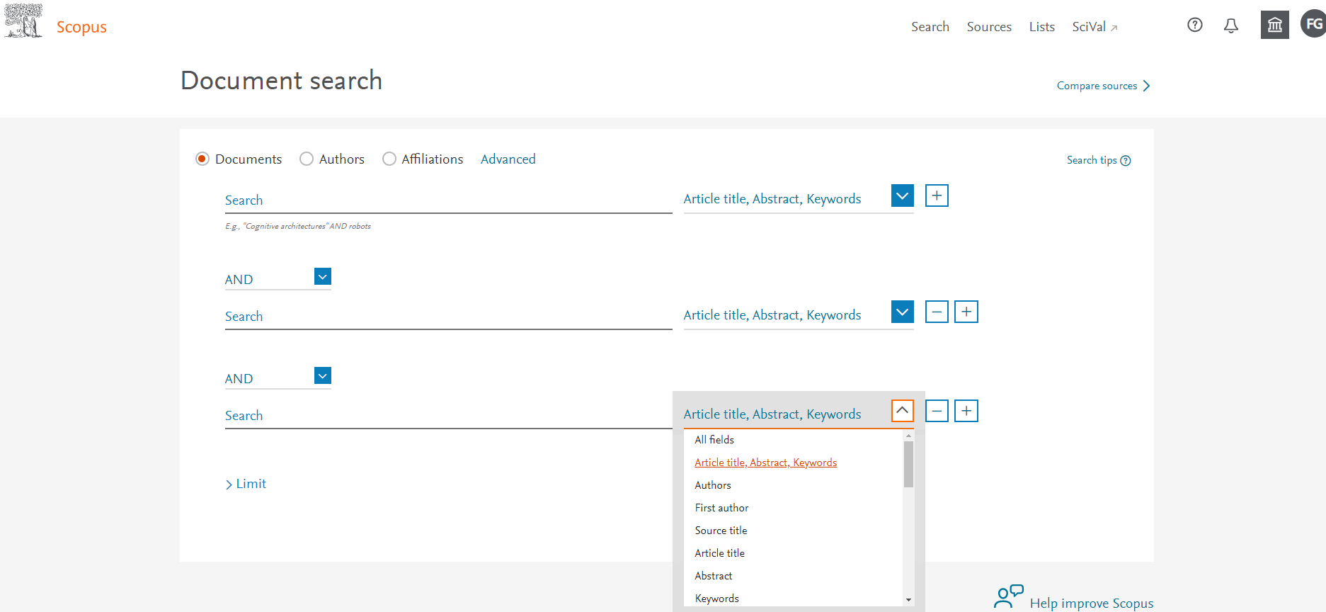
2. Develop a search
Title-Abs-Key (aldrin OR *chlordane OR chlordecone OR keptone OR *bromodiphenyl OR *BDE* OR "*brominated diphenyl*" OR *dicofol OR dieldrin OR endrin OR heptachlor* OR *bromobiphenyl OR HBB OR "*brominated biphenyl*" OR *bromocyclododecane OR *HBCD* OR *chlorobenzene)
OR
Title-Abs-Key (HCB OR PeCB OR *chlorobutadiene OR HCBD OR *chlorocyclohexane OR lindane OR *HCH OR mirex OR *chlorophenol OR PCP OR "*polychlorinated biphenyl*" OR PCB* OR "*polychlorinated naphthalene*" OR PCN* OR perfluoro* OR polyfluoro* OR PFOA* OR PFOS* OR PFAS*)
OR
Title-Abs-Key ("chlor* paraffin*" OR SCCP* OR *endosulfan OR toxaphene OR *chlorodiphenyl* OR *DDT OR *DDE OR *DDD OR dioxin* OR *dibenzo* OR PCD* OR "persistent organic pollutant*" OR organochlor*)
AND
Title-Abs-Key (*bird* OR avian OR passeri* OR {aves})
AND
Title-Abs-Key (field OR wild* OR “free-living” OR natural OR ecology*OR environment* OR ecosystem)
Scopus search:
1. POP search terms
2. Bird search terms
3. Wild population search terms
Notes:
So, this is the search that I decided on. Sorry, I know it isn’t pretty to look at. And I have my categories down the side, POPs, bird terms and wild population terms. And right away I am sure you can see that tissue distribution is not there.
That is for two reasons. Primarily it is because the paper pool I used here, I developed to be multi-use. This is a little out of the ordinary and for a meta analysis, definitely more debilitating more than anything. I have a paper pool for POPs in wild bird populations and I then categorised them for their different uses afterwards. The current other use for this paper pool is a meta analysis for student projects on the effects of POPs on reproduction.
The second reason tissue distribution is not in here is the validity of it. I am flagging this because you need to think very carefully about your search. I am comparing between tissues which is often not a paper’s main priority and thus is often not included in the abstract. I would also somehow need to work in the fact that I need to flag two of these tissues in my list not just one. In this situation, you have two options. Either figure out a way to search for multiple tissues and get less papers, or not include it, capture more papers and have a longer slog going through them looking for the papers you want. To me the second option is more reliable anyways.
So back to the search. I have highlighted a repeated phrase which stands for title-abstract-key words. This is what Scopus is set to search through and it is the default setting. It is the one we want anyways so, unless you have a reason to change this, I would just stick with it. I have also snapshot the list to give you an idea and as you can see by the scroll bar, there are a lot of different options.
In my search, POP is broken down into three as Scopus has a word limit for each search box which means you need to add more levels to get a more in-depth searches.

Slide 15
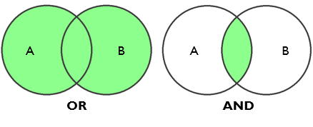
2. Develop a search
Title-Abs-Key (aldrin OR *chlordane OR chlordecone OR keptone OR *bromodiphenyl OR *BDE* OR "*brominated diphenyl*" OR *dicofol OR dieldrin OR endrin OR heptachlor* OR *bromobiphenyl OR HBB OR "*brominated biphenyl*" OR *bromocyclododecane OR *HBCD* OR *chlorobenzene)
OR
Title-Abs-Key (HCB OR PeCB OR *chlorobutadiene OR HCBD OR *chlorocyclohexane OR lindane OR *HCH OR mirex OR *chlorophenol OR PCP OR "*polychlorinated biphenyl*" OR PCB* OR "*polychlorinated naphthalene*" OR PCN* OR perfluoro* OR polyfluoro* OR PFOA* OR PFOS* OR PFAS*)
OR
Title-Abs-Key ("chlor* paraffin*" OR SCCP* OR *endosulfan OR toxaphene OR *chlorodiphenyl* OR *DDT OR *DDE OR *DDD OR dioxin* OR *dibenzo* OR PCD* OR "persistent organic pollutant*" OR organochlor*)
AND
Title-Abs-Key (*bird* OR avian OR passeri* OR {aves})
AND
Title-Abs-Key (field OR wild* OR “free-living” OR natural OR ecology*OR environment* OR ecosystem)
Scopus search:
1. POP search terms
2. Bird search terms
3. Wild population search terms
Notes:
The next thing of interest is the Boolean operators – these are just the AND and OR’s listed throughout. I have highlighted the AND break down so it searches through each category and OR is put between words of the same category. There are other types of operators and there are lots of help sheets on line to get you going. I already have a more indepth, how to use Scopus presentation that I can give out if anyone is interested too.

Slide 16
2. Develop a search
Title-Abs-Key (aldrin OR *chlordane OR chlordecone OR keptone OR *bromodiphenyl OR *BDE* OR "*brominated diphenyl*" OR *dicofol OR dieldrin OR endrin OR heptachlor* OR *bromobiphenyl OR HBB OR "*brominated biphenyl*" OR *bromocyclododecane OR *HBCD* OR *chlorobenzene)
OR
Title-Abs-Key (HCB OR PeCB OR *chlorobutadiene OR HCBD OR *chlorocyclohexane OR lindane OR *HCH OR mirex OR *chlorophenol OR PCP OR "*polychlorinated biphenyl*" OR PCB* OR "*polychlorinated naphthalene*" OR PCN* OR perfluoro* OR polyfluoro* OR PFOA* OR PFOS* OR PFAS*)
OR
Title-Abs-Key ("chlor* paraffin*" OR SCCP* OR *endosulfan OR toxaphene OR *chlorodiphenyl* OR *DDT OR *DDE OR *DDD OR dioxin* OR *dibenzo* OR PCD* OR "persistent organic pollutant*" OR organochlor*)
AND
Title-Abs-Key (*bird* OR avian OR passeri* OR {aves})
AND
Title-Abs-Key (field OR wild* OR “free-living” OR natural OR ecology*OR environment* OR ecosystem)
Scopus search:
1. POP search terms
2. Bird search terms
3. Wild population search terms
Notes:
I have used asterisks to replace multiple characters. For example here with passeri with an asterisk. This means that both passerine and the order Passeriformes would be encapsulated.

Slide 17
2. Develop a search
Title-Abs-Key (aldrin OR *chlordane OR chlordecone OR keptone OR *bromodiphenyl OR *BDE* OR "*brominated diphenyl*" OR *dicofol OR dieldrin OR endrin OR heptachlor* OR *bromobiphenyl OR HBB OR "*brominated biphenyl*" OR *bromocyclododecane OR *HBCD* OR *chlorobenzene)
OR
Title-Abs-Key (HCB OR PeCB OR *chlorobutadiene OR HCBD OR *chlorocyclohexane OR lindane OR *HCH OR mirex OR *chlorophenol OR PCP OR "*polychlorinated biphenyl*" OR PCB* OR "*polychlorinated naphthalene*" OR PCN* OR perfluoro* OR polyfluoro* OR PFOA* OR PFOS* OR PFAS*)
OR
Title-Abs-Key ("chlor* paraffin*" OR SCCP* OR *endosulfan OR toxaphene OR *chlorodiphenyl* OR *DDT OR *DDE OR *DDD OR dioxin* OR *dibenzo* OR PCD* OR "persistent organic pollutant*" OR organochlor*)
AND
Title-Abs-Key (*bird* OR avian OR passeri* OR {aves})
AND
Title-Abs-Key (field OR wild* OR “free-living” OR natural OR ecology*OR environment* OR ecosystem)
Scopus search:
1. POP search terms
2. Bird search terms
3. Wild population search terms
Notes:
Aves is another interesting one. When I had first run the search without the curly bracket I kept getting a lot of papers on building houses and street layouts and it took me a moment to realise that it was this causing it because Scopus ignores pluralisation so it was searching for ave which caught the word avenue. So when you develop your search just have a look at the kind of papers you are getting and it is always good to sense check as you go.
Sensing checking for me was the POP, DDD. I had initially written DDE twice accidentally and only realised 100 papers in so watch yourself, is all I’m saying.

Slide 18
2. Develop a search
2875 papers
Title-Abs-Key (aldrin OR *chlordane OR chlordecone OR keptone OR *bromodiphenyl OR *BDE* OR "*brominated diphenyl*" OR *dicofol OR dieldrin OR endrin OR heptachlor* OR *bromobiphenyl OR HBB OR "*brominated biphenyl*" OR *bromocyclododecane OR *HBCD* OR *chlorobenzene)
OR
Title-Abs-Key (HCB OR PeCB OR *chlorobutadiene OR HCBD OR *chlorocyclohexane OR lindane OR *HCH OR mirex OR *chlorophenol OR PCP OR "*polychlorinated biphenyl*" OR PCB* OR "*polychlorinated naphthalene*" OR PCN* OR perfluoro* OR polyfluoro* OR PFOA* OR PFOS* OR PFAS*)
OR
Title-Abs-Key ("chlor* paraffin*" OR SCCP* OR *endosulfan OR toxaphene OR *chlorodiphenyl* OR *DDT OR *DDE OR *DDD OR dioxin* OR *dibenzo* OR PCD* OR "persistent organic pollutant*" OR organochlor*)
AND
Title-Abs-Key (*bird* OR avian OR passeri* OR {aves})
AND
Title-Abs-Key (field OR wild* OR “free-living” OR natural OR ecology*OR environment* OR ecosystem)
Scopus search:
1. POP search terms
2. Bird search terms
3. Wild population search terms
Notes:
And when I ran this in Scopus, however long ago now, I got 2875 papers. I don’t think this is crazy numbers for a meta-analysis but you can definitely get less depending on your research question. Just play around with it, see what works best for you.
You will never be able to develop a search that will get all of the papers you are interested in. It is a trade off between the number of papers you have to comb through and the number of papers that match your research question.

Slide 19
3. Go through the abstracts to determine acceptability
Accepted
Not POPs
Not birds
Lab
Review
Editorial comment
Meta analysis
Captive
Modelling
Book chapter
Not available
Not English
Exclude? Note the reason alongside each paper:
It is important to be consistent:
Inclusion criteria clear beforehand
Struggling with a paper?
Not available?
If abstract is unclear, accept it!
Notes:
Once you have developed and sense checked your search it is time to go through the papers. Make sure you are clear on your inclusion criteria before you start because the last thing you want to do is have to go through this again because it can be really time consuming.
An example of this for me is wild populations. I came across papers that caught wild birds and housed them in aviaries before collecting tissue samples – for me, does that count? If you are not sure, make notes of questions as you go through and note which papers fall into that decision so you can easily go back later.
As you go through it is really important to note your reason to exclude each paper as you will need to be able to provide that information later. I have a small list of my reasons to give you an idea.
So, It is really important to be consistent:
Have your inclusion criteria clear in your head and stick to it
If you struggle with a paper, make a note of which and come back and reread it with fresh eyes.
Is the abstract not available on Scopus? Make a note and come back. It does not mean that you cannot get hold of the paper, it often just means needing to sign in to get it.
If at the end of the day, you are still unsure looking at the abstract, accept it! You can always exclude the full text article at a later date.

Slide 20
PRISMA diagram
Records identified through database searching (n = 2874)
Additional records identified through other sources (n = 367)
Identification
Records after duplicates removed (n = 3241)
Records excluded (n =2914)
Not studies on POPs
Does not measure two tissues
Not studies on birds
Not wild population
Experimental studies
Review paper
Not available
Not in English
Often included and I would recommend it
Identification ✓
Screening
Eligibility
Included
Screening
Records screened (n = 3241)
Eligibility
Full-text articles assessed for eligibility (n= 327)
Full-text articles excluded (n = 144)
Does not measure two tissues
Data shared with another paper
Dissimilarity between tissues (i.e. different location/year)
Dissimilarity between tissues (i.e. cross species comparison)
Missing statistics
Included
Included studies (n= 183)
Notes:
So the exclusion criteria come into play here – for the PRISMA diagram. You will more than likely publish this alongside your meta analysis in the appendix as it makes it clear that you have followed a non-bias process for collecting papers.
Some PRISMA diagrams have the numbers of papers alongside each reason which you can do. I am planning on updating mine to be like this because it is also important to keep track of each individual paper as it is simply good practise. You should know exactly what happened to each paper and be able to go back if you want to check something.
We also have this additional records box. So, you have your main search, so in this case Scopus, and you go through to abstracts to check for availability but there is also the issue that no search will find all your papers, so you need to widen the net. Now you do this through something called snowballing. There are other names for it that I cannot remember because snowballing is my favourite.

Slide 21
How to do a meta-analysis
Step 2: To snowball or not to snowball? Tis the question!
Notes:
So a quick run through snowballing

Slide 22
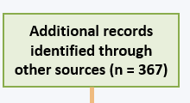
What is snowballing?
Often not discussed in the methods sections
Backward snowball – using reference lists of accepted papers to find new papers
Forward snowball – using citations of accepted papers to find new papers
If you do not snowball, it should be stated in your paper, alongside the reason
If you do snowball, you need to commit as this is a way of introducing bias
But can be spotted in a PRISMA diagram!
Notes:
So, snowballing is all about finding papers outside your search.
I am sadly not all knowledgeable in this topic. I have not seen a paper that has not snowballed but a previous supervisor advised me to either commit completely and snowball fully or not to bother at all. This is because to half complete snowballing, you are likely introducing bias. You either stick to your search or searches (as in using more than one search engine), or you accept that you may not have all the papers and own up to it in your study. This is, I guess, a systematic choice, if you are drowning in accepted papers, not snowballing might be something to consider.

Slide 23

What is snowballing?
Often not discussed in the methods sections
Backward snowball – using reference lists of accepted papers to find new papers
Forward snowball – using citations of accepted papers to find new papers
Backward snowballing
Forward snowballing
Notes:
There are two types of snowballing, backward and forward. Backward snowballing uses reference lists of accepted papers and forward snowballing is the opposite – looking at papers that have cited that paper.
So with snowballing you snowball the snowballs if that makes sense? Until you, I don’t know, run out of snow and no new papers are found. This is me being like no more papers.

Slide 24
How to do a meta-analysis
Records identified through database searching (n = 2874)
Additional records identified through other sources (n = 367)
Identification
Records after duplicates removed (n = 3241)
Records excluded (n =2914)
Not studies on POPs
Does not measure two tissues
Not studies on birds
Not wild population
Experimental studies
Review paper
Not available
Not in English
Screening
Records screened (n = 3241)
Eligibility
Full-text articles assessed for eligibility (n= 327)
Full-text articles excluded (n = 144)
Does not measure two tissues
Data shared with another paper
Dissimilarity between tissues (i.e. different location/year)
Dissimilarity between tissues (i.e. cross species comparison)
Missing statistics
Step 3: Finalising your data pool
Included
Included studies (n= 183)
Notes:
After snowballing, we have achieved the identification step of the PRISMA diagram and once you have been through your abstracts for the snowballed papers, you have completed the second stage, which is the screening process. Next comes the third step, which is finalising your data pool. Which aligns with the third step of the PRISMA diagram, eligibility.

Slide 25
Eligibility
Goal: go through full-text articles to ensure eligibility
Either download all the papers and check them for eligibility
Combine this with extracting all the data as you go
Me personally? Mystery option 3: a bit of both
Extracting stats is often the time-consuming part
Notes:
So in this, the goal is what is important: go through full-text articles to ensure eligibility. This includes matching all your criteria but also that the paper contains useable statistics.
How you go about this is more your choice. You can either go through them all to make sure they have what you need and then fill out your data, or you can combine this with extracting data.
Me personally, I go in the middle of this. Extracting the statistics themselves can be very time consuming and at this point in your meta analysis, there are likely a few ifs and buts that you want to first iron out. The main one being, do I have enough papers to do what I am trying to do? There is no point going through all the data extraction, if, at the end, you have 2 papers to include. Also, there are likely lots of different cofounding variables you want to include and you often have to chose.
This is of course dependent on your research question but the trick with a meta analysis, really, is planning.
So for me, it makes the most sense to be a little cautious in where I invest my time. And I will give you an example.

Slide 26
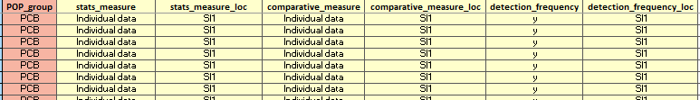
Initial Overview
3. Eligibility
Notes:
So, I call this my initial overview. That is my wording not meta analysis terminology. After reading the abstracts I have 327 papers from my initial 3000. I then, at this stage, go through all 327 papers and fill out my initial overview, which is all my basic information.
Go through
Important to do this is long format
The benefit of having a middle step like this, is you would be surprised what you think of. Whilst doing this, I thought of many other columns to add to the final one. I would also stress that if you are doing this in-between step, have your final spreadsheet already made. It is honestly so much easier to plan ahead and have everything clear in your mind rather than jumping straight in. The worst thing you can do is do all this work and then have to repeat it because you didn’t take a day or two to mull over your spreadsheet. At this point as well, you will also come across aspects to papers you didn’t forsee and they force you to make a decision. Have a word document where you write in any decisions you made, or anything tricky you have come across. It doesn’t have to be a word document, it can be a column at the end of the spreadsheet but trust me when I say you will not remember.

Slide 27
Decisions to make
3. Eligibility
Which tissue comparisons to include?
Which POPs to include?
Is there enough individual level data?
Notes:
After I went through all the papers, I took the time to then visualise my data and make my decisions. For me, I had three.
I want to have a comparison between invasive measures, non invasive measures and then a comparison between invasive and non-invasive measures. There is no point in me, using say papers that have a comparison against heart tissue and other invasive measures if I do not have any papers comparing heart tissue and non-invasive measures. So consistency among categories for me is important.
The next is that there are many different POPs that I can focus on and I need to make sure those papers are plentiful enough for me to make use of the data I am extracting.
And finally. Individual v population level measures. For a comparison between tissues, individual level measures such as a correlation coefficient are more informative but, unfortunately less common than population level measures such as means and SEs. If I have enough data at the individual level, I won’t need the population level stuff and extracting it all would be a waste of my time.

Slide 28
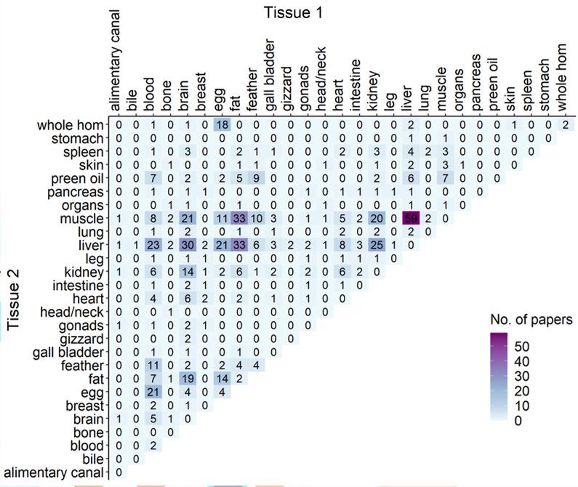
1. Tissue comparisons
3. Eligibility
Notes:
So, for the tissue comparisons, I decided heat maps would be the best way to go.
Now, my non-invasive measures are blood, feathers and preen oil, which I have highlighted for you to make this easier. Any data outside these are invasive measure comparisons, the cross sections are non-invasive comparisons and the ones that are elapsed by one box and the comparisons between the two.

Slide 29
1. Tissue comparisons
3. Eligibility
1. Invasive comparisons:
Brain, fat, kidney, liver, muscle

Slide 30
1. Tissue comparisons
3. Eligibility
1. Invasive comparisons:
Brain, fat, kidney, liver, muscle
2. Non-invasive comparisons
Blood, feather, preen oil

Slide 31
1. Tissue comparisons
3. Eligibility
1. Invasive comparisons:
Brain, fat, kidney, liver, muscle
2. Non-invasive comparisons
Blood, feather, preen oil
3. Invasive/non-invasive comparisons:
(Brain, fat, kidney, liver, muscle) vs (blood, feather, preen oil)
Notes:
So instead of collecting all the stats for all these tissue comparisons, I now know to narrow it down to these.

Slide 32
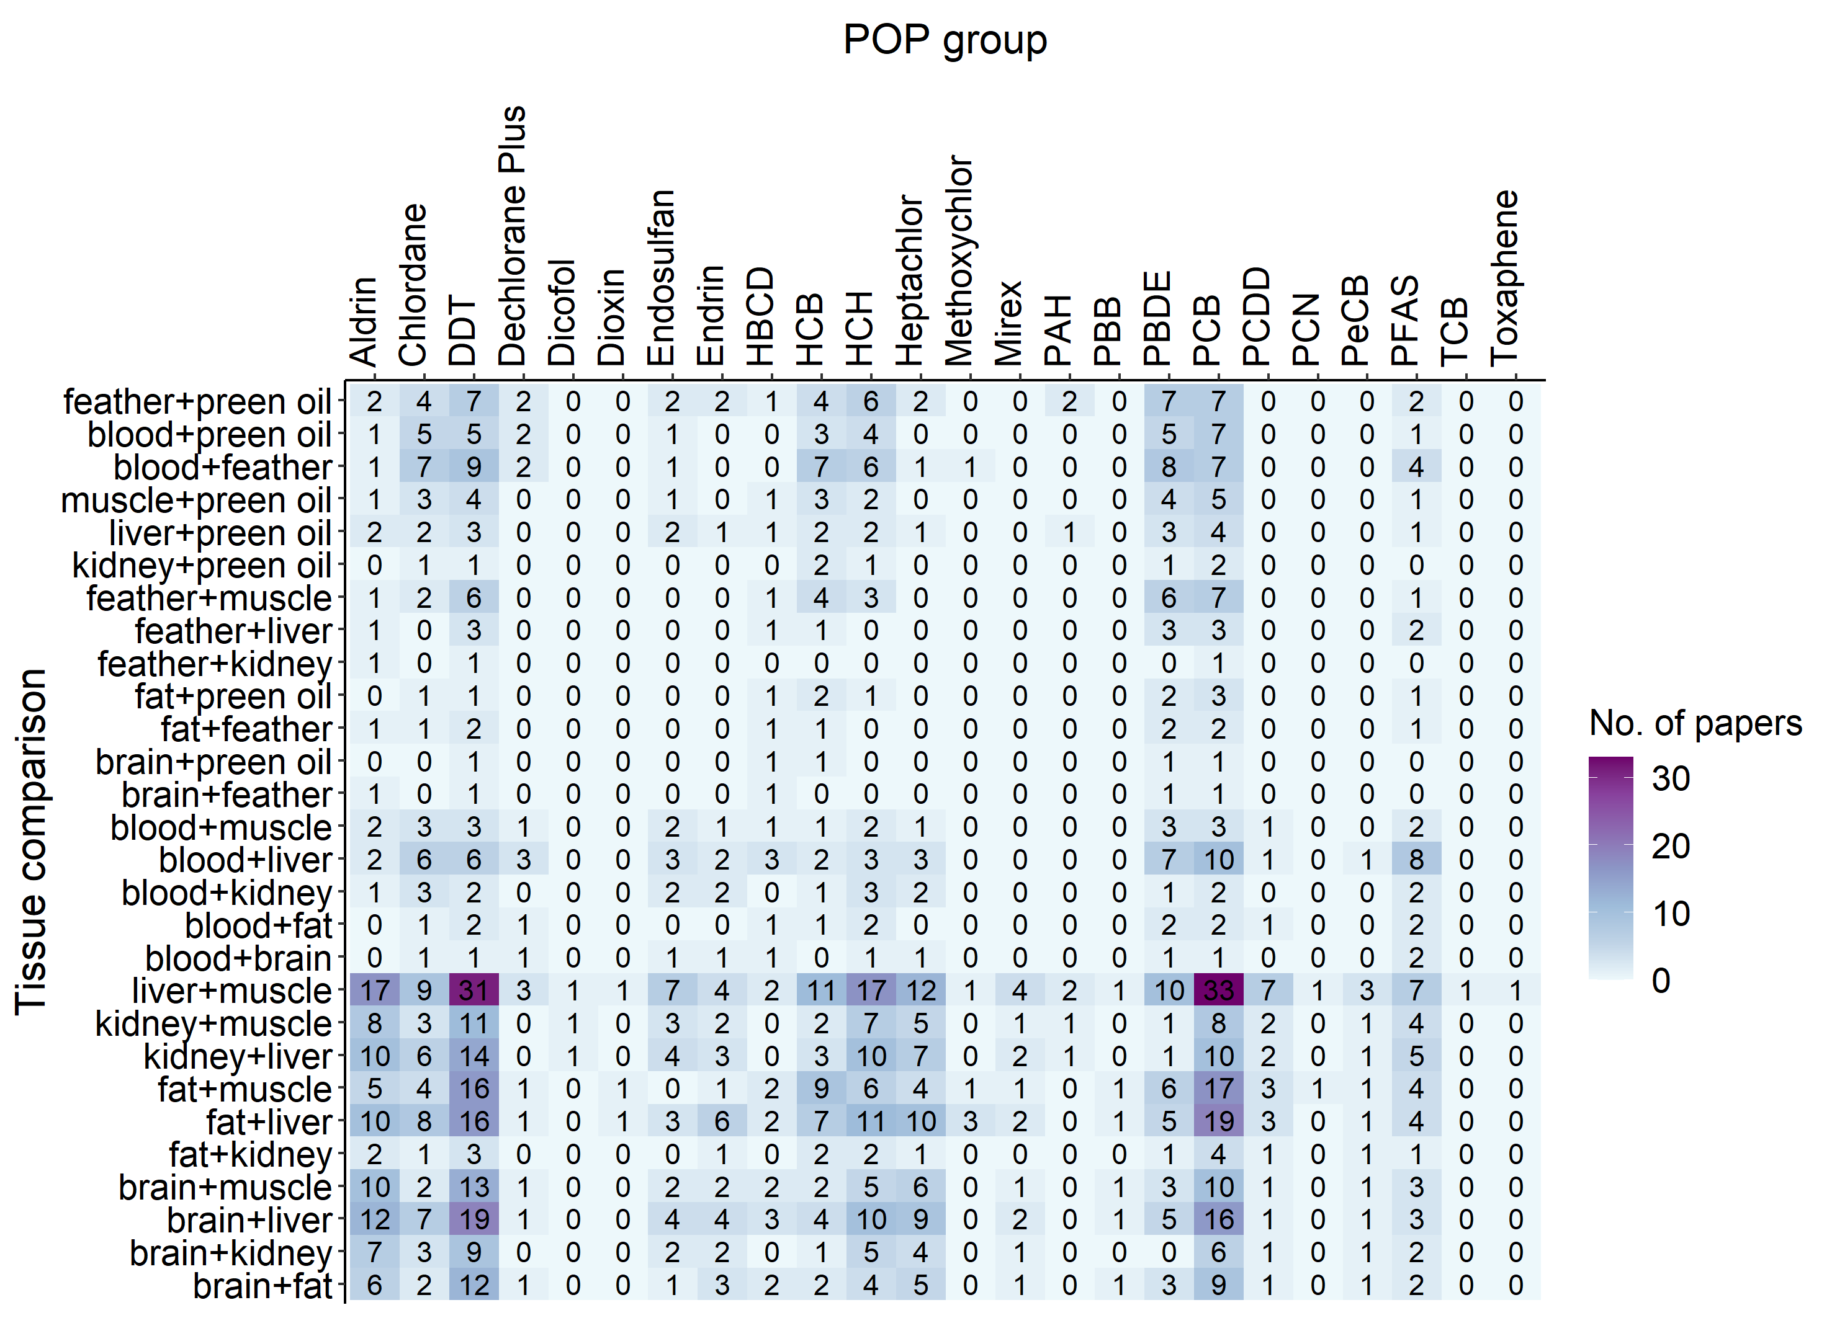
2. Which POPs?
3. Eligibility
P2
Chlordane
DDT
HCB
HCH
PBDE
PCB
PFAS
P3
P1
Notes:
I then took my selected tissue comparisons forwards to look at the POPs I can analyse.

Slide 33
2. Which POPs?
3. Eligibility
P2
Chlordane
DDT
HCB
HCH
PBDE
PCB
PFAS
P3
P1
Notes:
This is a great example of one that I would have wasted my time on.

Slide 34

Decisions to make
3. Eligibility
Which tissue comparisons to include?
Which POPs to include?
Is there enough individual level data?
Notes:
Sorry I don’t have a nice diagram for this individual level measures and, to be honest, I should have the information to hand and I don’t and I will be doing this tomorrow because it is so important to keep tabs on your decisions. I ran it in R, laughed about how little data there was for most sections and moved on but no, there’s not enough individual-level data for me to avoid collecting population level measures. It was totally wishful thinking but a girl can dream.

Slide 35
How to do a meta-analysis
Records identified through database searching (n = 2874)
Additional records identified through other sources (n = 367)
Identification
Records after duplicates removed (n = 3241)
Records excluded (n =2914)
Not studies on POPs
Does not measure two tissues
Not studies on birds
Not wild population
Experimental studies
Review paper
Not available
Not in English
Screening
Records screened (n = 3241)
Eligibility
Full-text articles assessed for eligibility (n= 327)
Full-text articles excluded (n = 144)
Does not measure two tissues
Data shared with another paper
Dissimilarity between tissues (i.e. different location/year)
Dissimilarity between tissues (i.e. cross species comparison)
Missing statistics
Step 3: onto the big spreadsheet
Included
Included studies (n= 183)
Notes:
So, that is all the ground work for getting to data extraction. I am now going to run you through my spreadsheet to really get you thinking about the scope of questions a meta-analysis can help you with.
I also want to help you feel more confident when doing this yourself by going through this in stages. There is very little help on line regarding this, all the help guides pretty much just say crack on and get the data and my main aim here is not to talk about my work but to help you get a feel for the process of doing a meta analysis.

Slide 36
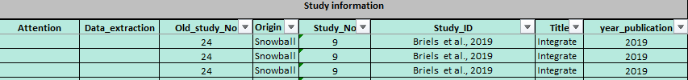
Study Information
Original search or snowballed paper
Year of publication
Paper tracking
Title for a quick paper search and fact check if I get muddled between papers
Notes:
Study info is a really boring one, but also so so so important. It is how you move around you spreadsheet. I can track my papers either by number or ID. I track with numbers too because I have some papers with the same first author and year and that can get a little confusing and all it takes is a slight oversight on your part and you have somehow lost a paper. Title also really helps here.
I also have year of publication. On a later section you will see that I have tracked when the data collection actually occurred in case I need/want temporal information but sometimes they do not include it. In this case, I am planning on back calculating the average gap between publication year and data collection year and fill in a proxy for that missing data.

Slide 37
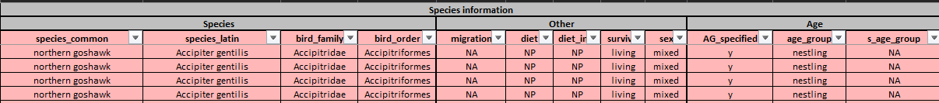
Species Information
Phylogeny
Migration
Diet
Age
Notes:
So, species common name and latin name are straightforward. I will be controlling for phylogeny in my meta-an analysis so, I need to go through the names and make sure there are no mistakes: which often occur in older papers as the phylogeny has changed or the species has been renamed. Some older papers genuinely just say crow or something like that so on occasion I have had to compare against geographical location to see if I can track the species down.
I also extract family and order when available for my phylogenetic tree. It is also important to extract a phylogenetic tree for each section (invasive, non-invasive and the comparison) to see how different these are to each other as this may be an issue later down the line.
Migration is an interesting one. If a population migrates, the POPs you measure are often a combination from both their wintering grounds and breeding grounds. And, as I already mentioned, tissues differ in their bioaccumulation of POPs so we would expect migratory birds to demonstrate more discord between tissues than resident birds.
Diet is definitely something that effects the POP concentrations in birds, so carnivores will more often than not have higher levels than insectivores, but I honestly do not know how it would effect tissue comparisons. Would high trophic birds show more discord between tissue measures because the influx of POPs is higher? No idea. Maybe. I use NP to stand for not provided. I do this because in my experience you should never leave a cell blank. When you go through this much data, when you go back to look at your spreadsheet at a later date – is the blank because the information wasn’t there? Or because I did this paper at 4am and I could have missed it.
Survival – this is to specify if the sampled individuals were alive or dead at sampling. I don’t mean that you would write dead for all invasive sampling, I mean if the bird was found dead you would but if it was shot for the study then you would write living. Bit of a depressing column but a potentially interesting column.
Sex – so this is mostly stated as mixed so probably won’t become anything but POPs are suggested to be higher in males as females offset POPs into their eggs so it is important to make a note.
Age – so I have a column for if they actually specify. You can tell the difference between nestling sampling and adult – shooting or nets to get the samples, means they are airborne and thus probably adults. It is important to note whether they state for the adults especially as the presence of juveniles is possible. If they do not specify, I write adult as a default. I think there a couple of papers where there are more juveniles than adults but it is usually a fair assumption. S_age_group is the secondary group, this is for when they state that there are both adults and juveniles.

Slide 38
Geographical/ temporal setting
Where
Breeding/wintering season
Data collection timeframe
Starting and ending month for data collection
Notes:
So, geographical is not really important for my meta analysis but it does help to spot multiple papers using the same population. What would be interesting though is their proximity to urban or agricultural life but I wouldn’t know how best to do that…
Timeframe is my way of understanding the data collection. Year start is the year data collection commenced and study length is how many years this went on for. Start and end month helps identify the month data collection started and ended.
Seasonal or all year round helps me understand whether, across multiple years, they sampled specific months year after year or if it was ongoing throughout the timeframe. This could link us back to migration in understanding when are where they are.
B_W is breeding or wintering grounds and is only filled in when the data collection was seasonal. Breeding doesn’t mean that they are a migratory bird but it could be quite telling. POP levels in adults often spike during breeding because the adults are using their fat reserves as chick rearing is energetically costly. When they burn this stored fat, they can remobilise stored POPs into their blood, causing the spike.
Season is if they mention summer or winter, and this will help me approximate months later if they were not stated.

Slide 39
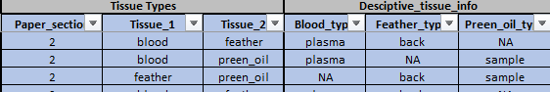
Tissues
Tissue comparison
Invasive – 1
Non-invasive – 2
In vs non-In - 3
Further tissue information
Notes:
Tissues is pretty straightforward.
Paper section is if the comparison is between invasive or non invasive samples or if it is comparing between the two.
Tissue 1 and 2 are the two tissues measured. I always alphabetise them to making grouping easier later.
Blood, feather or blood type is a bit more information on the sampling. Blood can either be plasma or whole blood samples. Feathers can depend on where they were taken and preen oil can be a non-invasive sample from the gland or processing the gland itself. More columns might be added if there is a distinguishing factor that comes to light in other samples as I go.

Slide 40
POPs
POPs analysed
Limit of quantification
Units
Notes:
POPs is the contaminant information.
So group or individual is whether the value given is for an individual POP or if they have clumped them together – a good example is PCBs which are present here. PCB-52 is the individual POP in the PCB category but other papers will collate multiple PCBs together. No. of POPs included is for the grouped information and the list is for me to write them all out (yay me).
LOQ is limit of quantification and is the minimum concentration the lab can comfortably quantify. This is the bar for the tests basically. This is important as data can come in as not detected for one of the tissues. In that instance, some papers will right the value down as half the limit of quantification. If they calculate a POP in one tissue and not the other, that is pretty telling for a comparison so I will likely do the same if the data is available.
We then have the units for both the limit of quantification for each tissue and the POP concentration itself. There is also the location of the limit of quantification if I need to find it again – usually the supplementary but here it was a different paper all together.

Slide 41
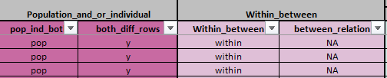
Population/individual measures
Within/between individual
Parent/offspring, sibling, colony
If there are population and individual data for this POP but other information differs
Notes:
Population and/or individual is the types of data available to me. Population level data is overall data about the population – for example, the mean and SD. The individual level data is data which uses each individuals values for each tissue. An example of this is a correlation. Obviously, individual level is better when comparing between the two tissues but more often than not, population level is the only one available. Both_diff_rows is saying that there are population level and individual level but they are different in other information so I have had to use two different rows for the same information.
Within and between individual is as it sounds. Whether the two tissues have come from the same individuals and if not, the relationship between the individuals – so parent/offspring/ siblings/ colony. Again, I mentioned this when I excluded egg data, within individual is better but we are not excluding between individual just yet.

Slide 42

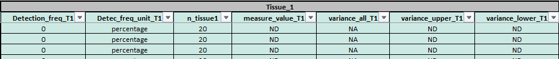
Population level statistics
Notes:
Location is where the data is in the paper to help me find it again if I need to.
Individual data – this column is already filled in for me from my previous review of the data so it is just to guide me on whether or not I need to keep scrolling to fill in data
Lipid percentage is often highly correlated with POP concentrations as POPs are lipidphilic so it is good to have this information if it is available.
Measure and variance type is simply what data is available for POP concentrations.
Detection location is how many positive results you have from your samples – basically how many are above limit of quantification.
The next two segments are the same – one for tissue 1 and the other from tissue 2. We have detection frequency and unit. Sample size and the measurement values for the POP concentration

Slide 43
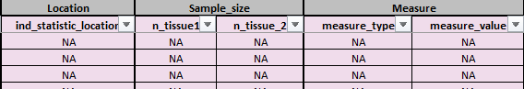
Individual level statistics
Notes:
This is the same again but for the individual level statistics. We have the sample sizes, the measurement type, often R or R2 and then the value itself. We have two different sample sizes as they are sometimes unclear between the population level statistics and the individual level so I make the assumption that I will just go for the lower value

Slide 44
Statistics
You need:
Effect size
Sample sizes
Effect size: reflects the magnitude of the treatment effect or (more generally) the strength
of the relationship between two variables
Three main types of effect sizes. The summary data…
is reported as means and SD/SE in two groups
is based on a binary outcome
is a correlation between two variables
My population level data
My individual level data
Notes:
Outcome measure and its corresponding variance
Binary outcome such as events and non-events.

Slide 45
Statistics
Binary data
Continuous data
Correlational data
Standardised mean difference (Cohen’s D)
Log odds ratio
Fisher’s Z
Bias-corrected standardised mean difference (Hedges’ g)
Notes:
The most commonly used for continuous data is Cohen’s D but there is also Hedges, g, which can be used as Cohen’s D has a slight overestimation in small samples.

Slide 46


Statistics
Fixed effect:
all studies share the same true effect size
Random effects model:
assume the true effect size varies from study to study

Slide 47
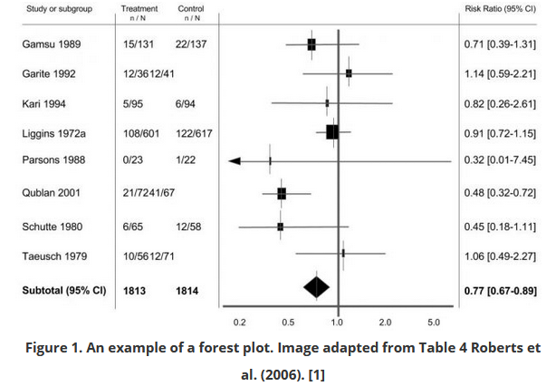
Forest plot
Outcome effect
Confidence interval
Individual studies
The line of null effect
Overall effect
Dependent on effect size and data input
Notes:
The x axis scale can change dependent on the type of effect size you are using

Slide 48
Tips
Never leave a cell in your spreadsheet blank (! = needs inputting, NP = not provided, NA = not applicable)
If you use Scopus, you can save your list of papers from your search. If you save the search it will keep adding new papers and the numbers start changing
Try and only do everything once – forward planning is your friend. Having a brain storm with friends is very helpful
Use colour in you spreadsheet – breaks sections up to stop you getting lost (and it’s more fun to look at)
Always have a Scopus/snowball column

Slide 49
Thank you for listening. ☺
My trusty meta-analysis book is “Introduction to meta analysis” by Micheal Borenstein – sooooo helpful!

